Slide 1
Deep learning for time-series
Assignment 2

Slide 2
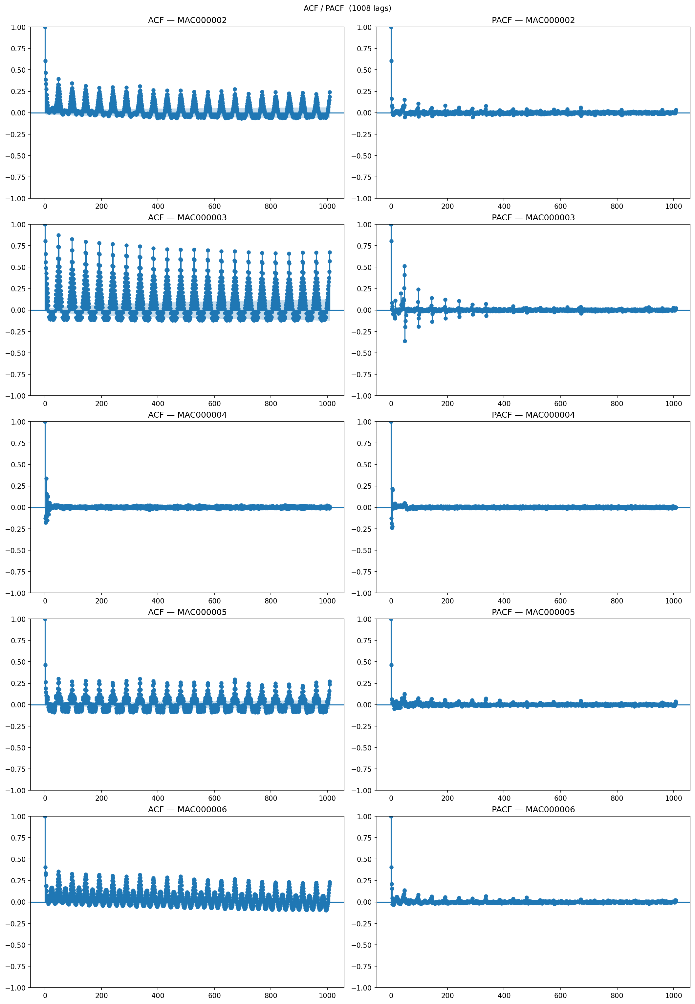
Task 02 – Missing Data & Imputation
House quality filter
Drop household if either - more than 10% of values are missing - a gap is longer than 48 hours (aggressive)
Seasonal mean imputation
Energy demand follows strong daily and weaker weekly cycles. Seasonal (48 slots) mean preserves the daily pattern; plateau would be introduced by forward-fill. NaN-values are filled with mean of all previous values at 48-slots intervals. Could be improved with rolling window since the PACF shows drop-off.

Slide 3
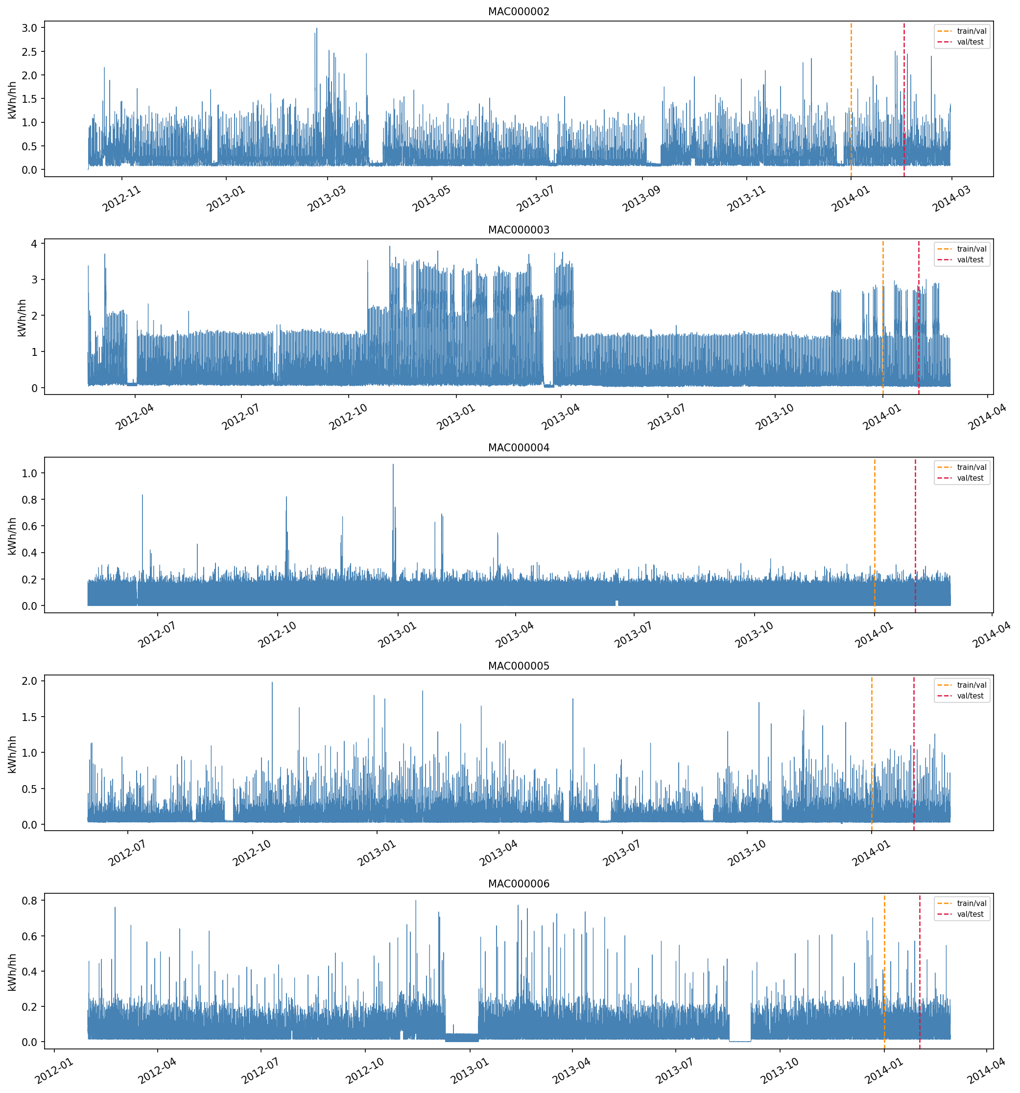
Task 04 – Stationarity & Trend Analysis
ADF Stationarity Test (p < 0.05)
All 5 households stationary across all regression types (c, ct, ctt)
Mann-Kendall Trend Test
MAC000002: Decreasing trend (p=0.000)
MAC000003: Decreasing trend (p=0.000)
MAC000004: No trend (p=0.876)
MAC000005: Decreasing trend (p=0.000)
MAC000006: No trend (p=0.341)
White Test (Heteroscedasticity)
MAC000002: LM=20,916, p=0.000 — Heteroskedastic
MAC000003: LM=32,059, p=0.000 — Heteroskedastic
MAC000004: LM=28,532, p=0.000 — Heteroskedastic
MAC000005: LM=27,357, p=0.000 — Heteroskedastic
MAC000006: LM=33,301, p=0.000 — Heteroskedastic

Slide 4
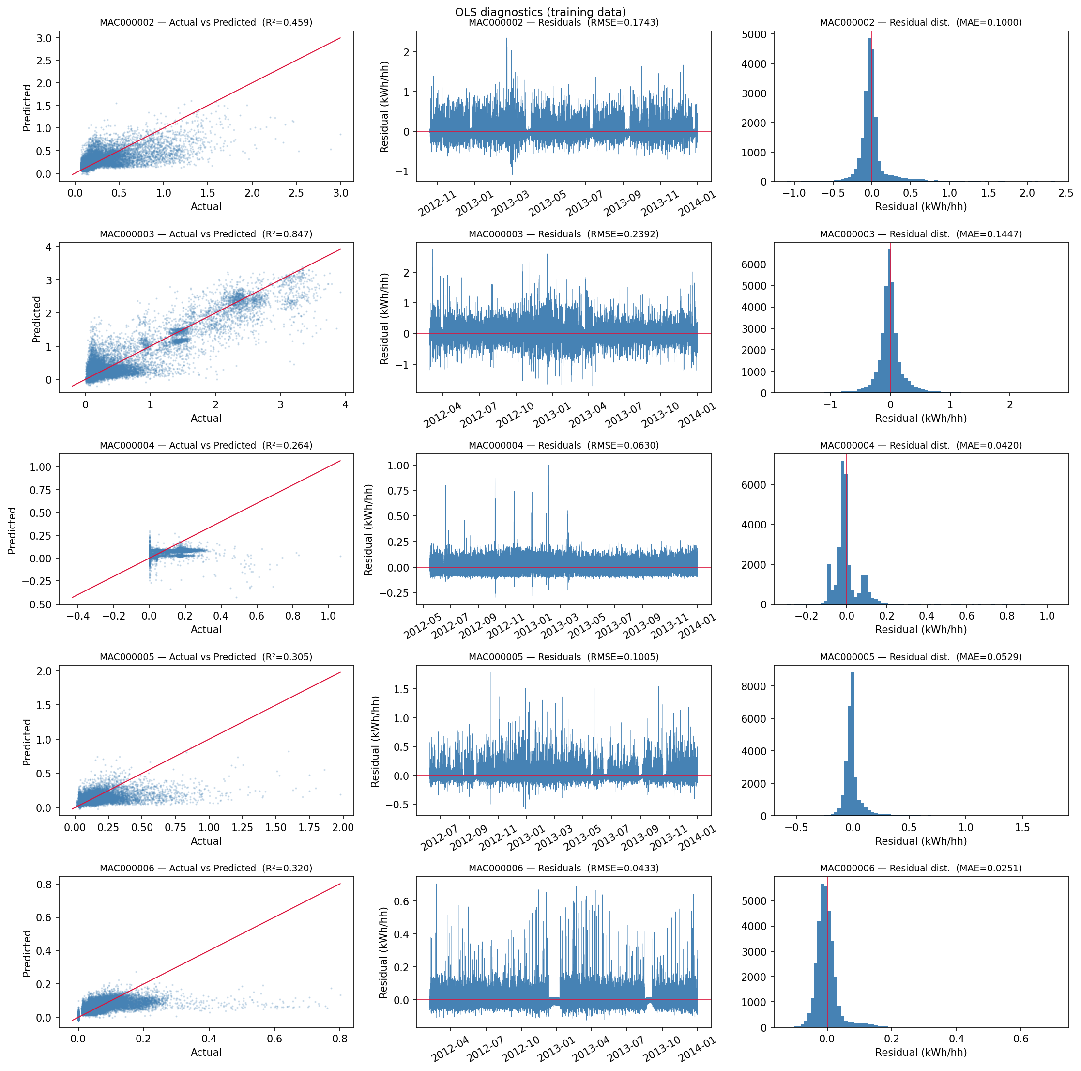
Task 04 – Diagnostics &Transforms
Diagnostics and transforms
ACF shows significant periodicity – seasonal transform is fitting
White test shows heteroskedasticity and OLS shows left skewed residuals – log-transform and robust errors might be fitting for models other than tree-based.
Mann-Kendall trend tests shows significant trends, but they are deemed spurious.

Slide 5
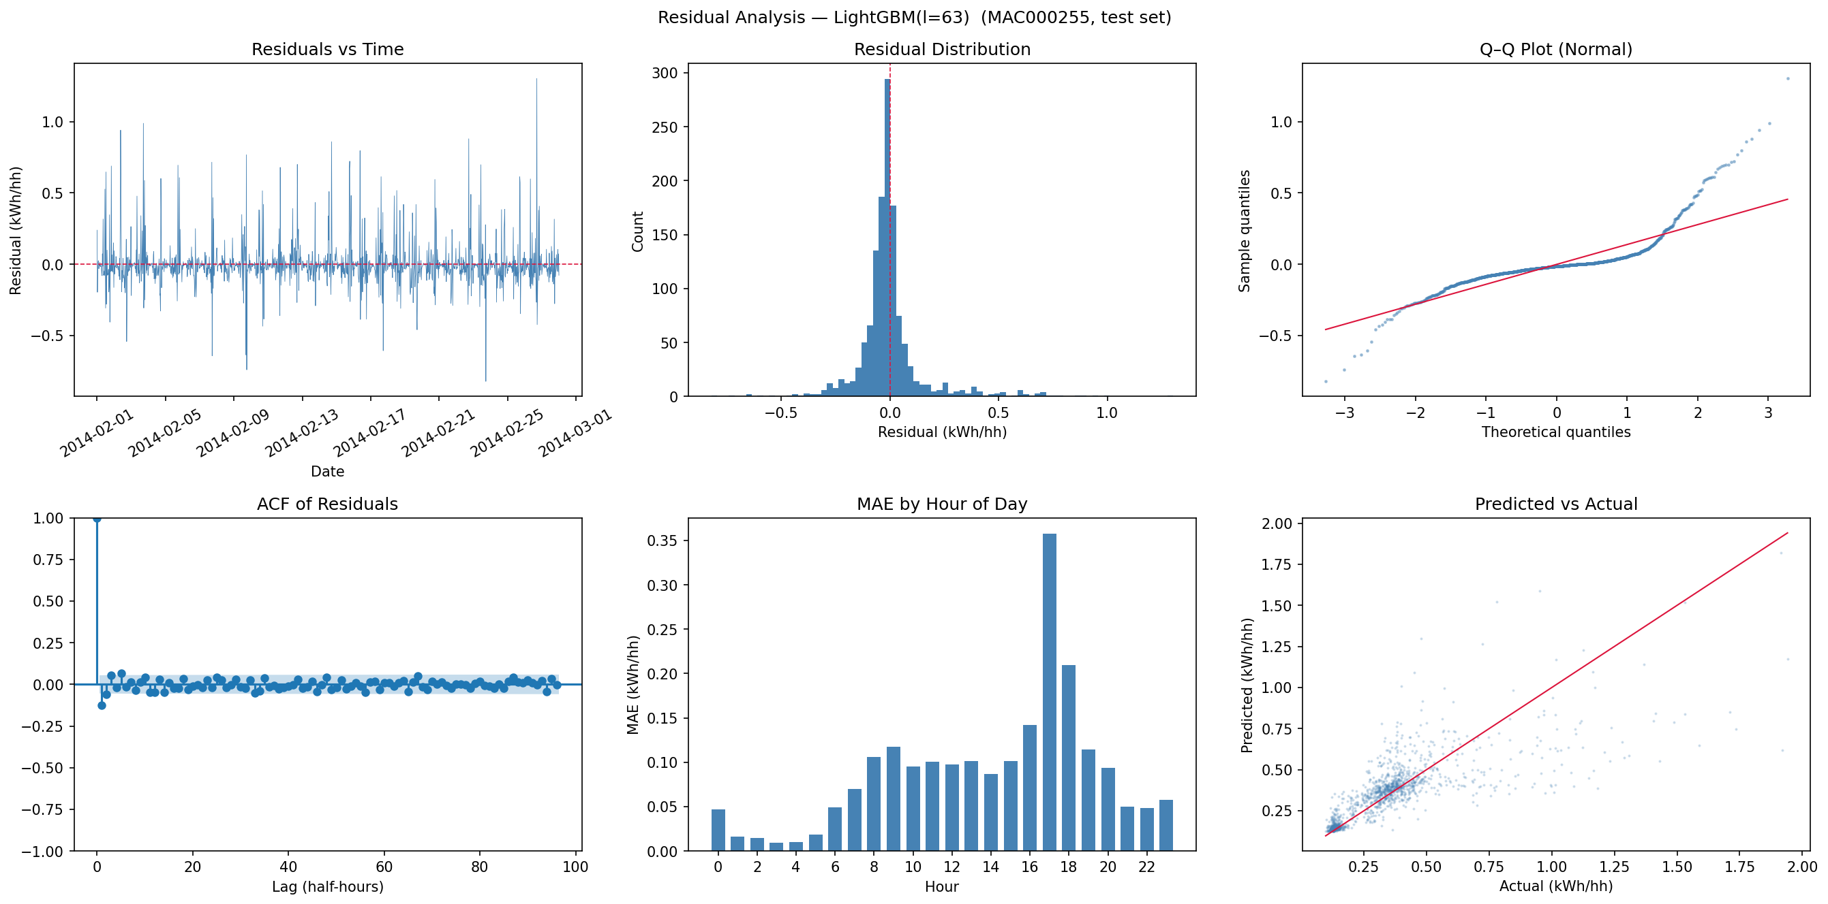
Task 06 – Local Model: Single Household
Model Selection
Six models compared:
LinearRegression
Ridge(a=1.0)
Lasso(a=0.01)
DecisionTree(d=8)
RandomForest
LightGBM(l=63)
Transform: Log + deseasonalising (period=48)
Results
Best model: LightGBM(l=63)
Val MASE: 0.550 | Test MASE: 0.568
Val MAE: 0.085 | Test MAE: 0.088
ACF lag-1: -0.126 (significant, does not completely capture autocorrelation)
Fig 6: Residual analysis — LightGBM on household MAC000002 after log-deseasonalising

Slide 6
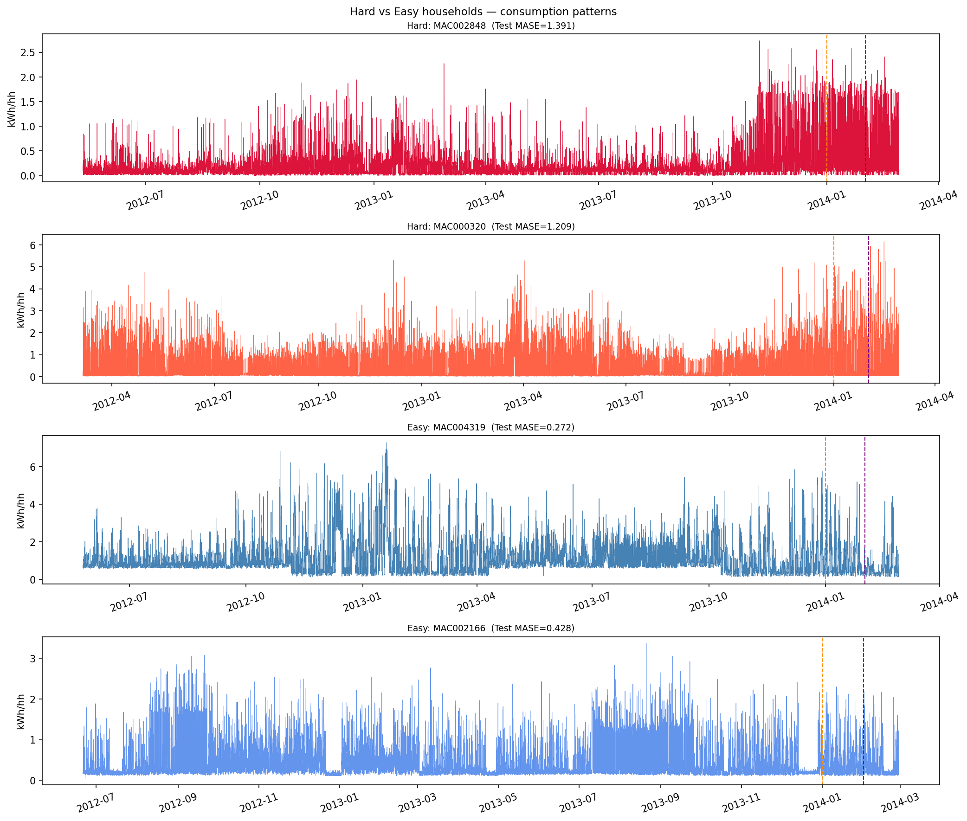
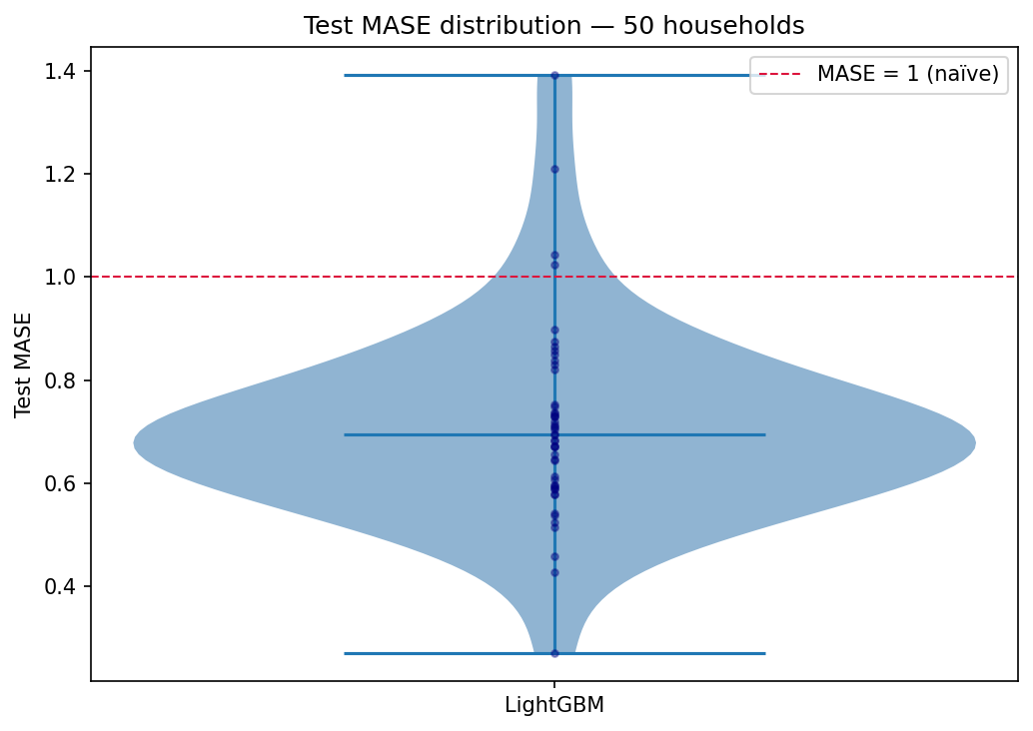
Task 07 – Local Cohort Analysis
Cohort-Level Results
Same LightGBM + log-deseasonalising pipeline applied to the full cohort (50 households)
Cohort mean test MASE: 0.711 | std: 0.187
ACORN Subgroup Analysis
Households split by ACORN classification (Affluent, Comfortable, Adversity)
No strong subgroup effect observed (Kruskal-Wallis) — individual household variance dominates
Easy households (low consumption variance): mean MASE: 0.44
Hard households (erratic patterns): mean MASE: 1.11
Key Finding
Forecasting difficulty is driven more by household behavioural variance than by demographic group

Slide 7
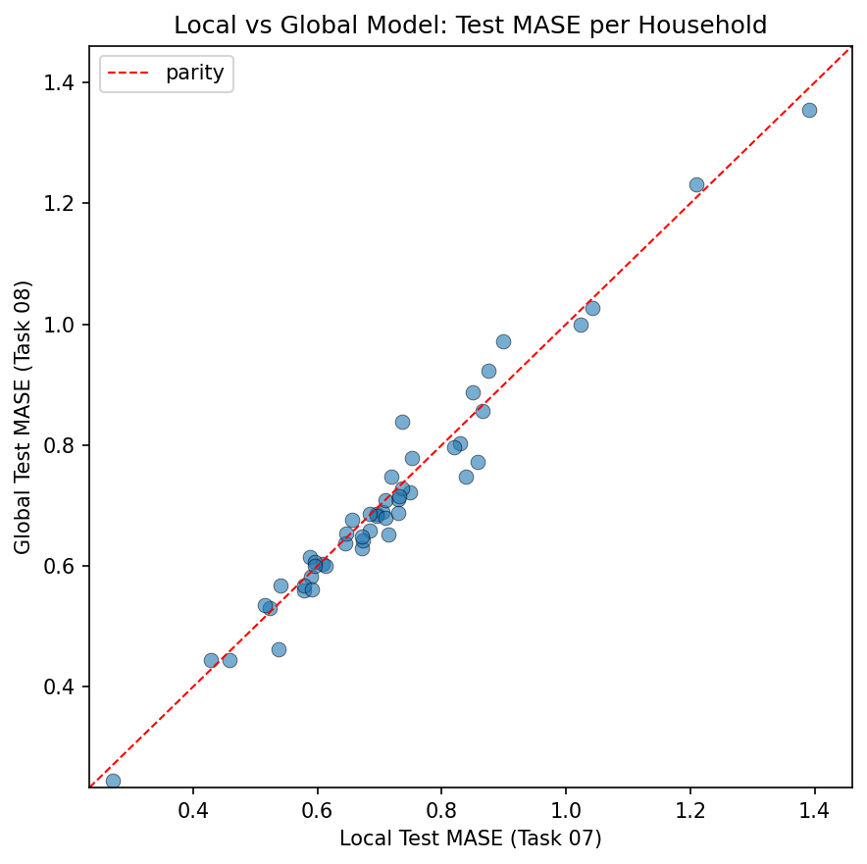
Task 08 – Global vs Local Models
Global Forecasting Model
One LightGBM trained on ALL households simultaneously (pooled data)
Learns shared patterns across the population
Head-to-Head Comparison
Local models (Task 7)
Val MASE 0.726 | Test MASE 0.711
Val RMSE 0.223 | Test RMSE 0.219
Global model (Task 8)
Val MASE 0.721 | Test MASE 0.703
Val RMSE 0.225 | Test RMSE 0.221
Interpretation
Global models win slightly in MASE but not in RMSE. Interpreted as a better understanding of general trends but less sensitive to household specific patterns and the model is therefore underfitted to outliers.

Slide 8
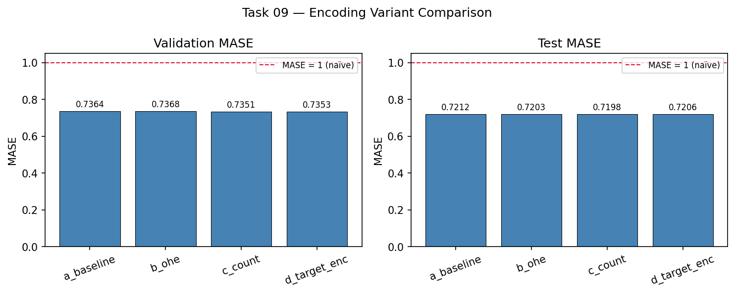
Task 09 – Global Model with Meta-Features
Motivation
The GFM (Task 8) treats all households identically; adding meta-features allows it to specialise by demographic group
Meta-features available: stdorToU (pricing plan), Acorn (20-category), Acorn_grouped (5-category)
Encoding Variants Tested
a_baseline: no meta-features (Task 8 GFM)
b_ohe: one-hot encoding of Acorn_grouped
c_count: count encoding of Acorn (category -> frequency)
d_target_enc: target encoding of Acorn (category -> mean consumption)
Results
Best: one hot encoding
Val MASE: 0.7187 | Test MASE: 0.7013
Marginal improvement over baseline (0.7033 → 0.7013)
All encodings perform similarly — meta-features give modest signal.
Since there is not a lot of variance between groups (Kruskall-Wallis test) there is no big difference in the encoding of the groups.

Slide 9
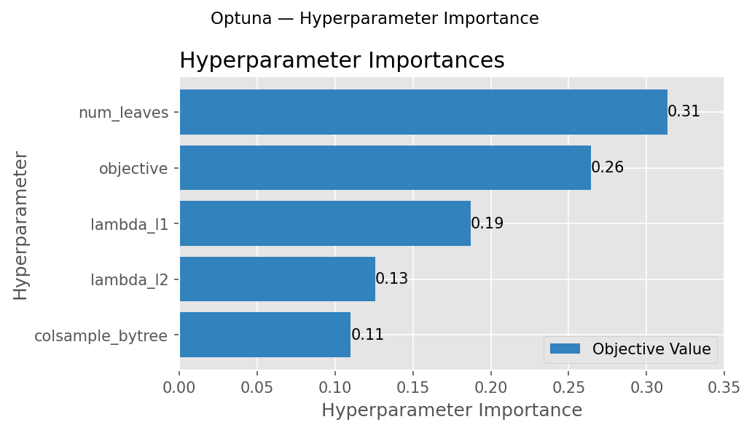
Task 10 – Hyperparameter Tuning
Search Strategies Compared
Tuning summary
=================================
Strategy configs Val MASE Wall time
Grid 27 0.5887 101.3s
Random 5 0.5852 21.3s
Bayesian 5 0.5808 23.0s

Slide 10
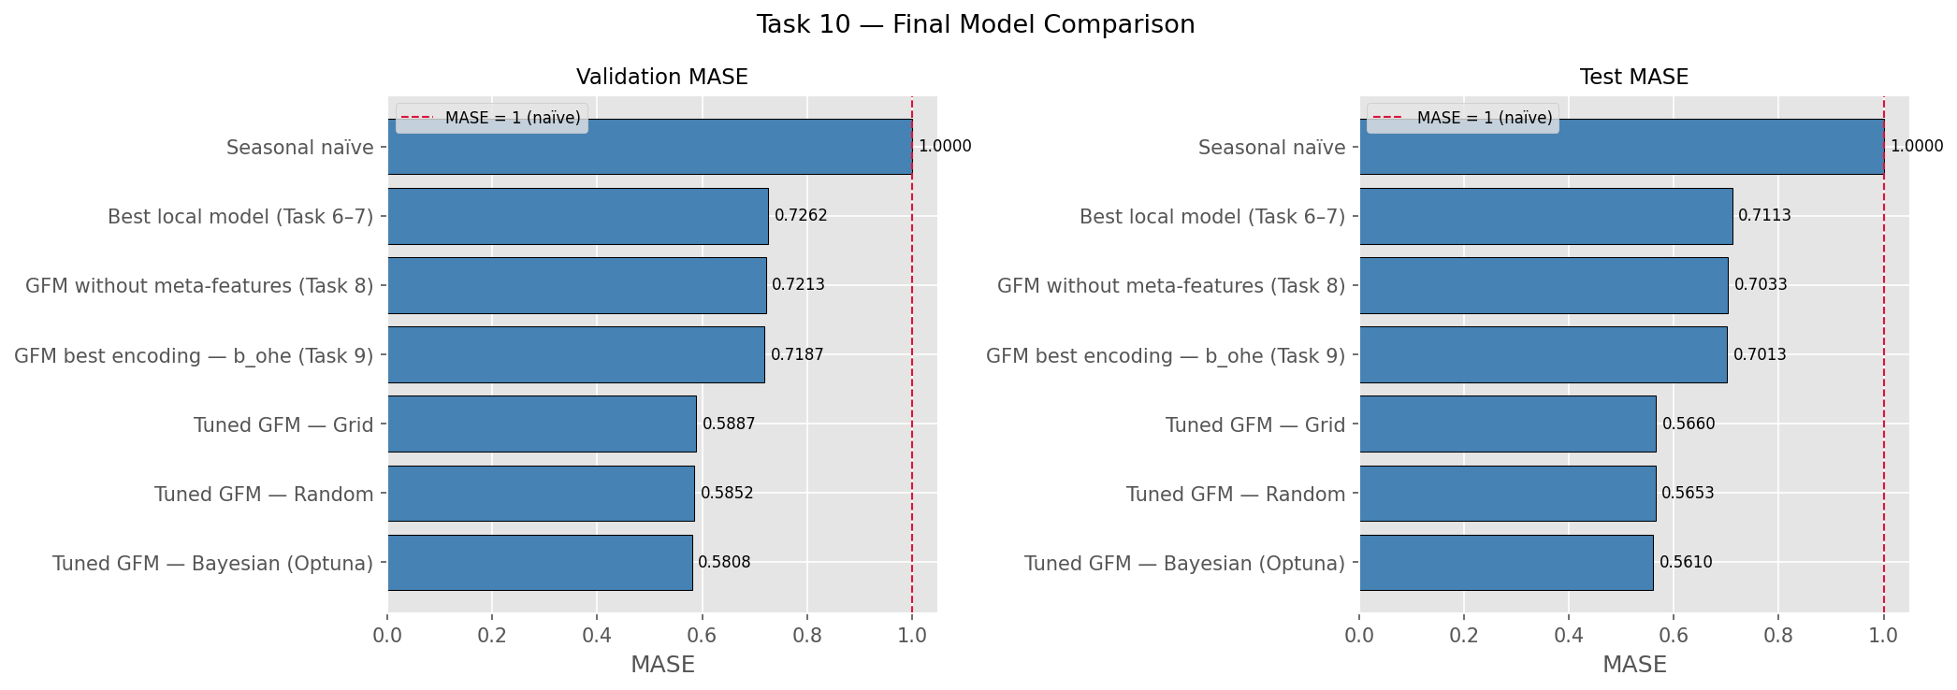
Task 10 – Final Results & Conclusions
Full Model Progression (test)
Seasonal naive baseline: MASE = 1.000 (reference)
Local model (Tasks 6): MASE: 0.568
Cohort model (Task 7): MASE: 0.711
Global model, no meta (Task 8): MASE 0.703
Global + count encoding (Task 9): MASE: 0.701
Tuned GFM — Grid: MASE = 0.566
Tuned GFM — Random: MASE = 0.565
Tuned GFM — Bayesian (Optuna): MASE = 0.561
Key Takeaways
- Bayesian tuning delivers the best model
- Tuning matters more than local-vs-global choice: tuned GFM beats untuned local models (0.684 vs 0.721)
Final recommendation: a tuned global LightGBM with one hot encoded meta-features — scalable to all 5,566 households without per-household retraining.
num_leaves: 88
objective regression_l1
colsample_bytree 0.979
lambda_l1 8.324
lambda_l2 2.123
n_estimators 500
learning_rate 0.05
min_child_samples 20
subsample 0.8

Slide 11
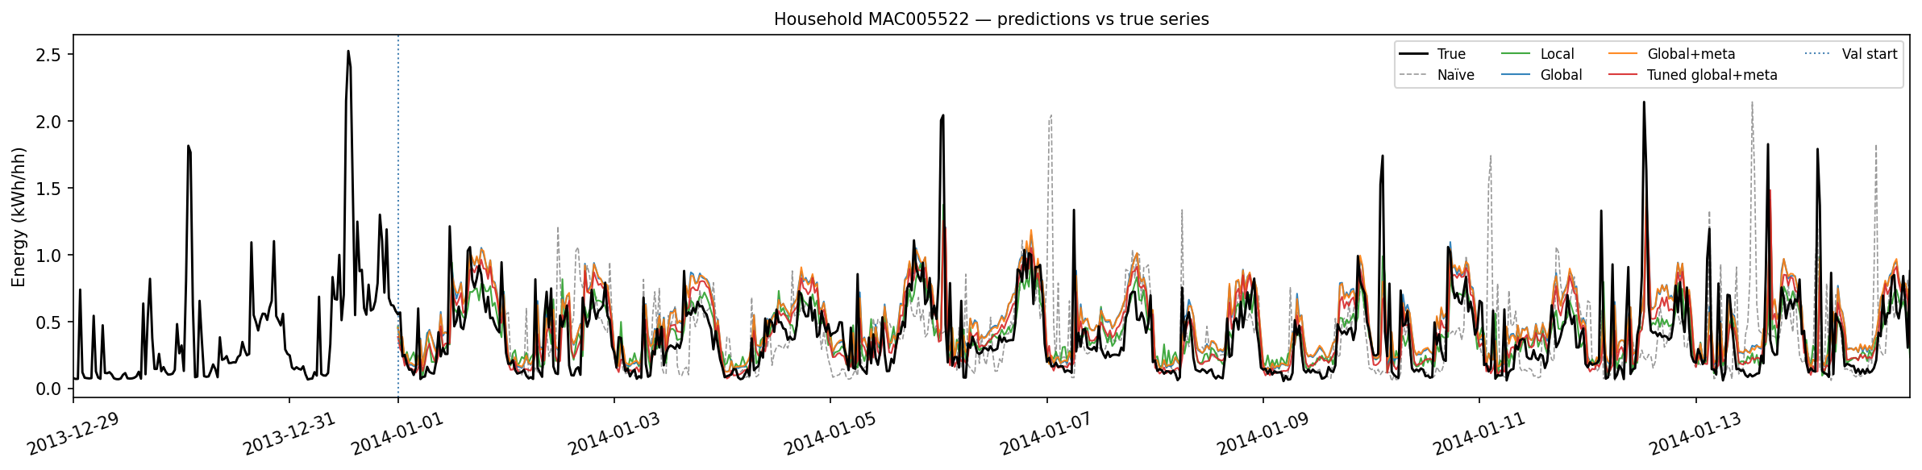
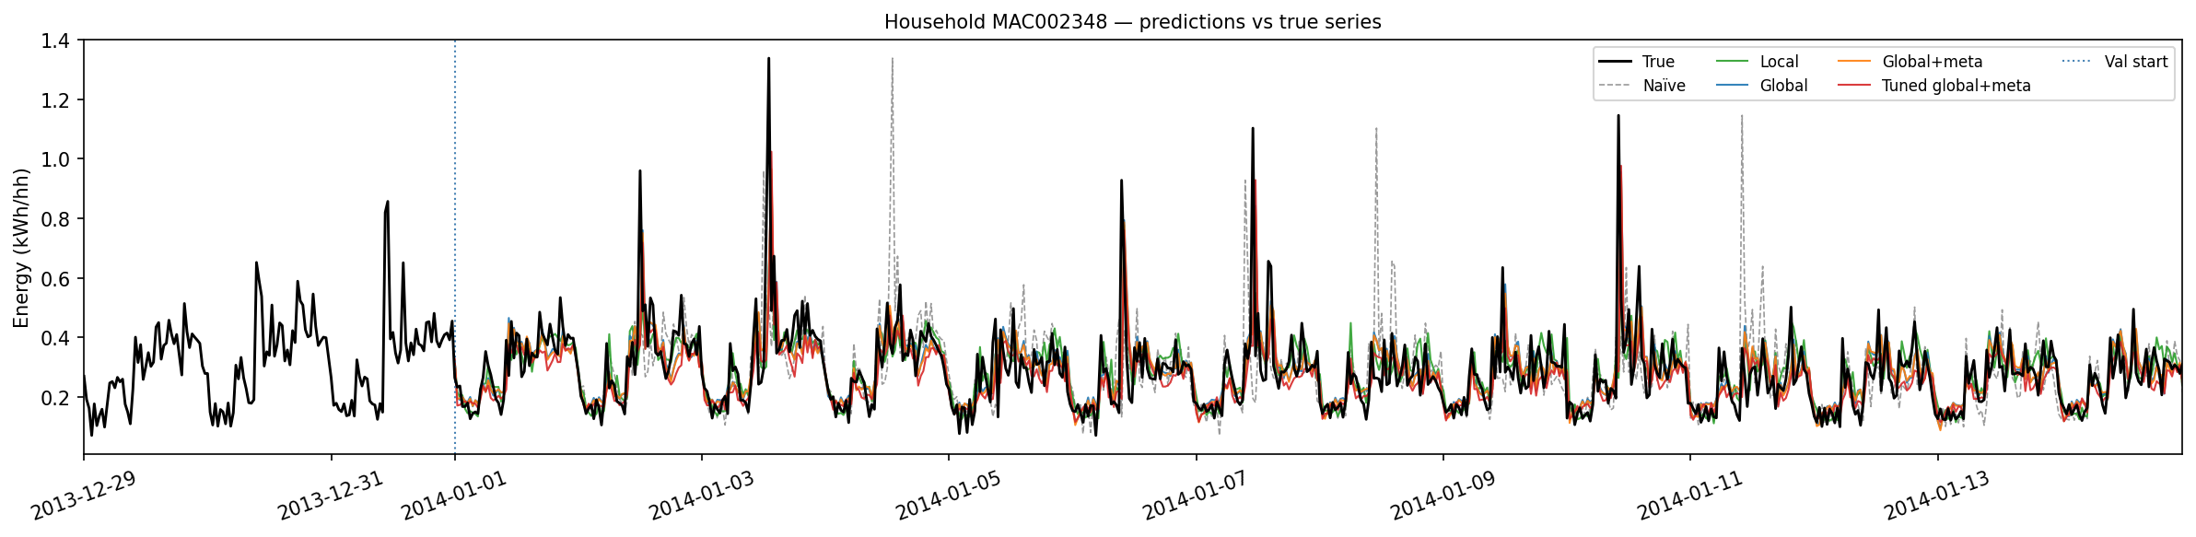
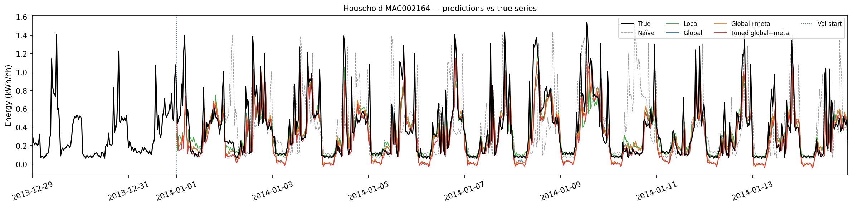
Prediction visualization

